Slide 1
Functions and Global Variables
A supplemental lesson for AP CSP

Slide 2
Functions Review
For a long time now, since the early missions, you have been encouraged to use functions in your code.
When you first started using functions, you identified places in your code that were repeated.
You created a function for the repeated code.
  Gave it a name.
  Coded the function.
  Called the function.

Slide 3
Functions Review
More recently, you created and used functions with parameters.
Parameter: information the function needs to complete the task.
Parameters are a form of procedure abstraction. They make functions more flexible. You can use them for many different values and variables, instead of creating a function for every instance.

Slide 4
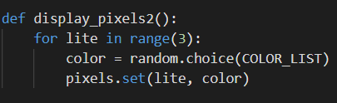
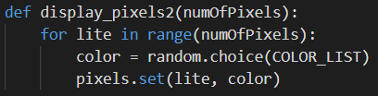
Functions and Parameters Review
In this example:
The first function turns on all four pixels.
Instead of creating three more functions that can turn on one, two or three pixels, you can create a function.
The second function uses a parameter for the number of pixels to turn on.
The information you give the function is called a parameter.

Slide 5

Functions and Parameters Review
In this example:
You use the parameter in the function code to complete the task.
When you call a function with a parameter, you must give the value in the function call.
This is called an argument.

Slide 6
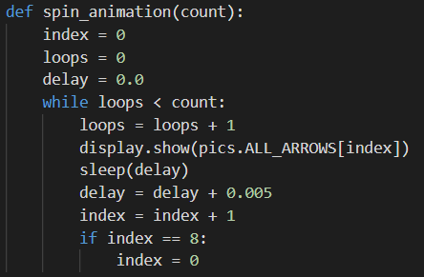
Functions and Local Variables Review
Sometimes you create and use local variables in a function.
They do not exist and cannot be used outside the function.
They are not used anywhere else in the code.
They are only used in the function.

Slide 7
Parameters and Local Variables Review
So how do you determine what variable is a parameter and what is a local variable?
Here are some standard rules for parameters:
If a variable is used in a calculation (right side of = )
If a variable is used in a condition (if statement)
If a variable is used in a condition (loop)
Here are some standard rules for local variables:
If the variable is being calculated (left side of =)
If the variable is the counter in a loop
Note: There isn’t one right way to use parameters and local variables.
There are many possible solutions.

Slide 8
Global Variables
But every now and then …. Not very often ….You use a variable that needs to be accessed in several functions, and it needs to keep its value throughout.
Global Variable: a variable declared outside a function (like in the main program) and can be accessed throughout the program

Slide 9

Global Variables
So far you have used a few global variables:
color
delay
choice
index
You might have changed the value of the variable, but that was in the main program and not in a function.

Slide 10
Global Variables
You really want to keep it that way – use as few global variables as needed.
But SOMETIMES you need a global variable whose value will change inside a function
Examples:
  A variable that counts something (like the number correct)
  An index of a list, if scrolling left or right
  The amount of a delay that changes during the program code

Slide 11
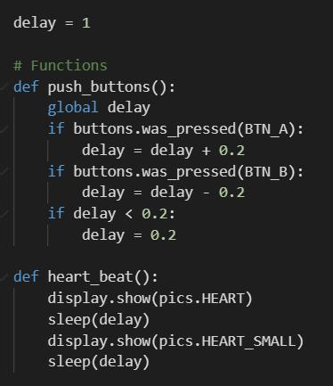
Functions and Global Variables
Example #1: Heartbeat program (Heart2)
delay is a global variable
The push_buttons() function changes the value of delay.
The heart_beat() function uses the value of delay.

Slide 12
Functions and Global Variables
Example #1: Heartbeat program (Heart2)
The delay is used and changed in push_buttons().
delay is also used in heart_beat().
You want the variable to keep its value after the function ends.
Use the statement:
global delay
to keep the updated value.

Slide 13
Functions and Global Variables
Example #1: Heartbeat program (Heart2)
The delay is used but not changed in heart_beat().
It does not need the statement:
global delay
The global statement is only needed when the variable’s value is changed in the function.

Slide 14
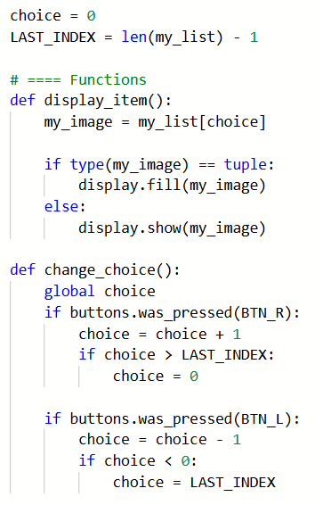
Functions and Global Variables
Example #2: Billboard_functions (Mission 7)
choice is a global variable
It is used like as an index, to access an element in the list.
The display_item() function uses the value of choice.
The change_choice() function uses and changes the value of choice.

Slide 15
Functions and Global Variables
Example #2: Billboard_functions (Mission 7)
The choice (as an index) is used and changed in change_choice().
choice is also used in display_item().
You want the variable to keep its value after the function ends.
Use the statement:
global choice
to keep the updated value.

Slide 16
Functions and Global Variables
Example #2: Billboard_functions (Mission 7)
The choice (as an index) is used but not changed in display_item().
It does not need the statement:
global choice
The global statement is only needed when the variable’s value is changed in the function.

Slide 17
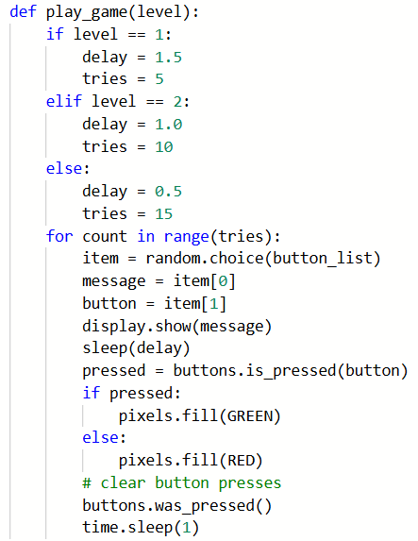
Functions and Variables
How can you avoid using a global variable?
Sometimes you can’t.
The first two examples show a specific instance when a global variable must be used.
But other times, with a little creativity, they can be avoided.
This can specifically happen when a function calls another function.

Slide 18
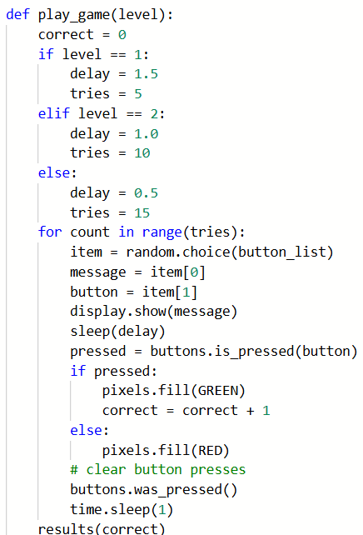
Functions and Variables
Example #3: PT_Practice2
Go the Sandbox in CodeSpace.
Open PT_Practice2
Use File → Save As… to rename the file: PT_Practice2_results
Initialize correct.
Increment correct when the correct button is pressed.

Slide 19
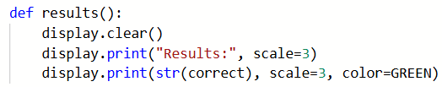
Functions and Variables
Example #3: PT_Practice2
Create a new function that will display the results.
Your function can look something like this ↓

Slide 20
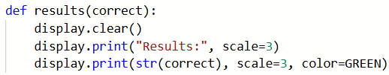
Functions and Variables
Example #3: PT_Practice2
Now you are probably thinking that correct needs to be global.
It is being used in two functions.
This is where programming creativity comes in.
The play_game() function can call the results() function and pass the value of correct to a parameter in results().

Slide 21

Functions and Variables
Example #3: PT_Practice2
Add the function call to results() in the play_game() function.
Watch the indenting! It is outside the for loop block.
Run the program and test the results.

Slide 22
Create PT Requirements
Example #3: PT_Practice2
Let’s add a little more code to results() to meet the requirements for the Create PT.
The play_game() function also uses the variable tries, which is the total number of guesses.
You can use the variable to calculate the percent correct.

Slide 23
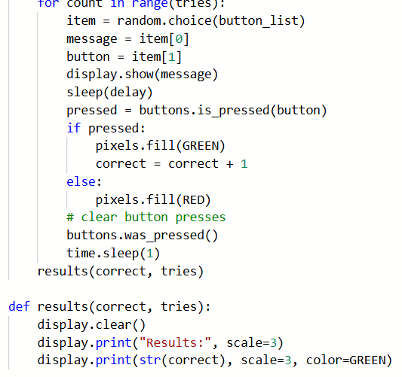
Create PT Requirements
Example #3: PT_Practice2
Include tries as an argument in the results() function call.
Include tries as a parameter in results() function.

Slide 24
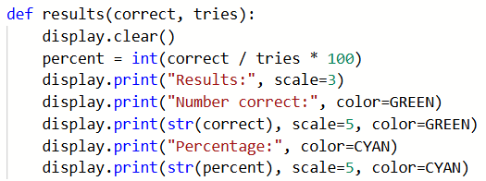
Create PT Requirements
Example #3: PT_Practice2
Use tries to calculate the correct percentage.
Display the percentage.

Slide 25
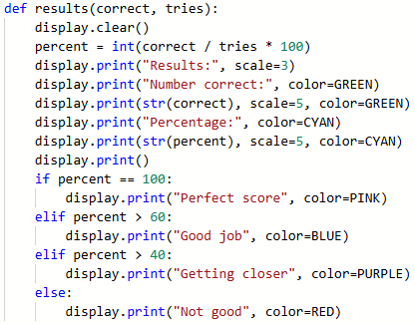
Create PT Requirements
Example #3: PT_Practice2
Add an if statement. Display a message about their results.
Use percent instead of correct so the messages will work with any of the games.
The messages could be something like this.

Slide 26
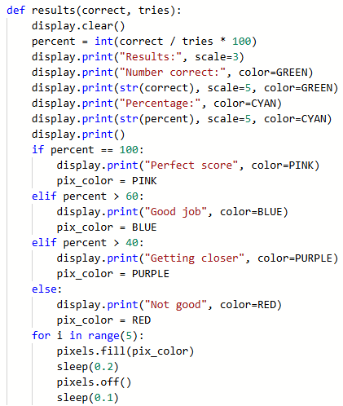
Create PT Requirements
Example #3: PT_Practice2
Add a for loop to flash the pixels a specific color.
Here is an example

Slide 27
Create PT Requirements: Function
Example #3: PT_Practice2
Review the function.
Does it meet the requirements for the function part of the Create PT?
  Function has a parameter
  Parameter is used in an if statement
  Function has a loop
  Function has an if statement

Slide 28
Create PT Requirements: Function
Example #3: PT_Practice2
This an alternative for the PPR.
The play_game() function uses a list, which meets the list requirements.
If you don’t want to add levels to the play_game() function, you can add a different function, like results() to meet the Create PT requirements.

